Slide 1
Introduction to Java for C++ Programmers
Understanding Concurrency in Java using Threads
Professor: Reza Khojasteh

Slide 2
Introduction to Threads in Java
A thread is a sequence of executing instructions that can run independently.
The Java Virtual Machine allows an application to have multiple threads of execution running concurrently. Each thread is associated with an instance of the class Thread.
Threads organize programs into logically separate paths. They can perform tasks independent of other threads and can share access to common resources.
Note that you can’t control OS behaviour. Do not rely on thread priority for algorithm correctness.

Slide 3
Introduction to Threads in Java – cont’d
Integrated support for threads is a key facet of Java technology; use concurrency as a normal programming style in Java.
There are two strategies for using Thread objects:
1. Directly control thread creation by building a Thread object.
2. Abstract thread management by passing application’s tasks to an executor.
Check MyExamThread.java, MyExamRunnable.java, and SimpleThread.java.
Notes:
Thread constructor takes as an argument a Runnable object. The Runnable interface has only one method that takes no arguments and returns nothing:
new Thread( new Runnable() {
public void run() {System.out.println(10);}
}).start();
The Runnable interface expressed as lambda expression is:
() -> System.out.println(10)
Therefore, replacing the Runnable (functional) interface with its lambda expression in the Thread constructor gives the solution:
new Thread(() -> System.out.println(10)).start();

Slide 4
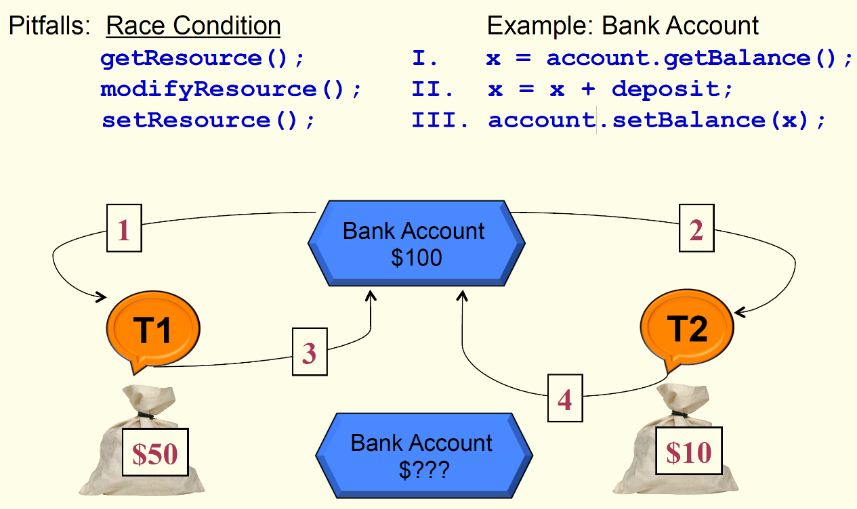
Threads Synchronization In Java - Introduction
Any part of the code in a program with the property that only one thread can execute it at any given time is called critical section. Critical sections are also called monitors.

Slide 5
Threads Synchronization In Java - Intrinsic Lock
Synchronization is built around the concept known as the intrinsic lock; every object has an intrinsic lock associated with it.
A thread that needs access to an object’s monitor must acquire the object's intrinsic lock; a thread must release the intrinsic lock when it's done with an object.
A thread is said to own an object’s intrinsic lock from the time it acquires until the point it releases that.
Any other threads will block when they attempt to acquire an object’s intrinsic lock, if that lock is currently owned by another thread.

Slide 6
Threads Synchronization in Java - synchronized
When a thread invokes a synchronized method, it automatically acquires the intrinsic lock for that method's object.
In a synchronized method, the thread releases the acquired lock when the method returns.
Synchronized statements must specify the object that provides the intrinsic lock.
In a synchronized statements, the thread releases the acquired lock when the last statement is executed.
Check SynThread.java and BankCredit.java.

Slide 7
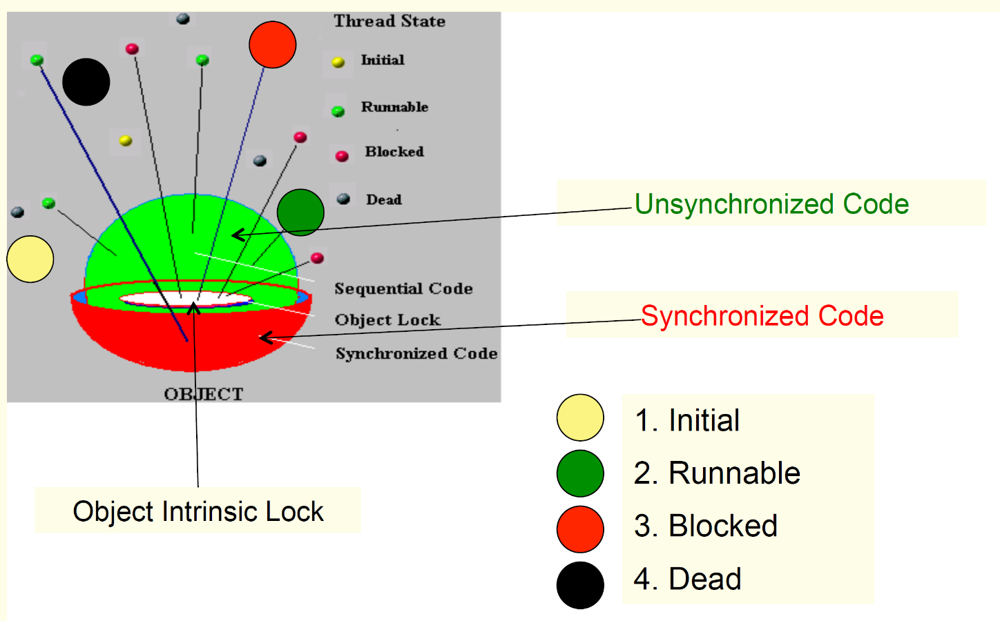
Threads Synchronization in Java – Synchronized vs. Unsynchronized Parts

Slide 8
Threads Synchronization in Java - Liveness problems
Liveness problems could happen while running a concurrent application:
When two or more threads are blocked forever, waiting for each other, we define the liveness problem as being a deadlock (Check Deadlock.java.)
Starvation describes a situation where a thread is unable to gain access to shared resources and is unable to make progress (for ever!)
A thread often acts in response to the action of another thread. If the other thread's action is also a response to the action of another thread, then livelock may result. Note that in a deadlock, threads are blocked while in livelock, threads are alive but stuck!
Common Solutions to liveness problems:
Immutable Objects
High Level Concurrency

Slide 9
Guarded Blocks - Introduction
Threads must coordinate their actions (they must work together,) hence guarded block is the most common coordination mechanism for threads coordination.
The guarded block uses three methods form Object class.
wait() causes the current thread to wait until another thread invokes the notify() method or notifyAll() method for this object. It makes a thread wait and places the invoking thread on the monitor’s waiting list until some conditions are satisfied.
When wait() is invoked, the invoking thread releases the lock and suspends its execution. Note that you should always invoke wait() inside a loop that continuously checks for the condition being waited on (check BeCarefulAboutWait.java).

Slide 10
Guarded Blocks – cont’d
notify() wakes up a single thread that is waiting on this object's monitor and notifyAll() wakes up all threads that are waiting on this object's monitor.
These last two methods tell waiting thread(s) that something has occurred that might satisfy that condition. They basically reactivate one/all threads on an object monitor’s waiting list and inform them that something important has happened.
notify() method doesn't allow you to specify which thread should be woken up; that would be, again, OS’s call.
Check SharedResource.java.

Slide 11
Immutable Objects and High - Level Concurrency Objects
If the state of object is not changed after its creation, the object is called an immutable object (e.g. String object).
Since an immutable object cannot change its state, it cannot be corrupted by thread interference.
High-level concurrency objects are implemented in the java.util.concurrent package and include Lock & Condition objects, Excecutors & Thread pools, concurrent collections, and atomic variables.

Slide 12
Threads and Functional Programming
Check FunctionalExample.java.
Check MethodReferenceExample.java.
Check InstanceMethodReferenceExample.java.
You could also use these Lynda.com resources:
Understanding Lambda Expressions (from Lynda tutorial)
Functional Interfaces
Using built-in Functional Interfaces

